Slide 1
Validator Workshop
Logan Saether
logan@web3.foundation

Slide 2
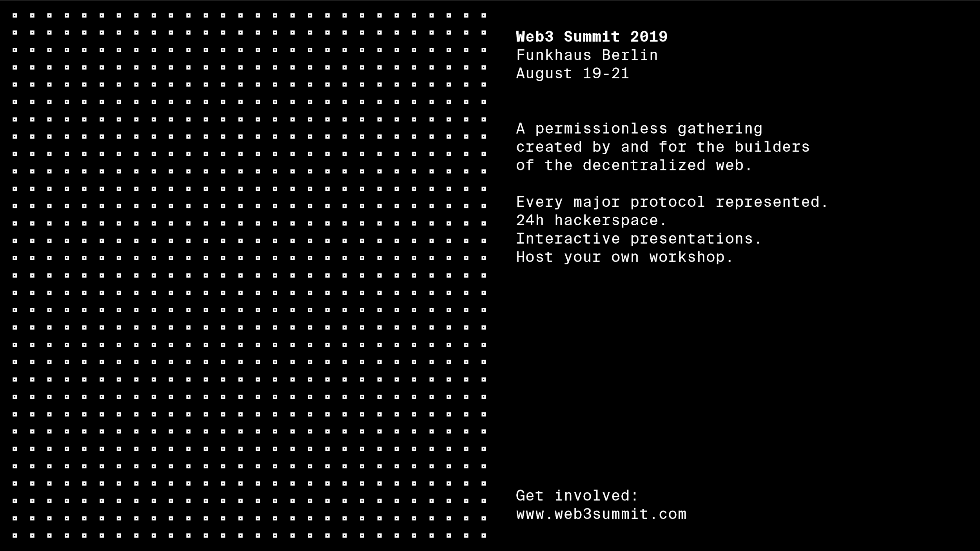


CALL FOR CONTRIBUTORS
Researchers
Parachain Implementers
Educators
Community Leaders

Slide 3
Agenda

Slide 4
Agenda
What is Polkadot?
Consensus
BABE
GRANDPA
NPoS
Being a Validator
Requirements
Slashing
Rewards
Security
Q&A / Networking
Workshop
Set up a validator
Q&A / Networking
Notes:
Introduce myself

Slide 5
What is Polkadot?

Slide 6
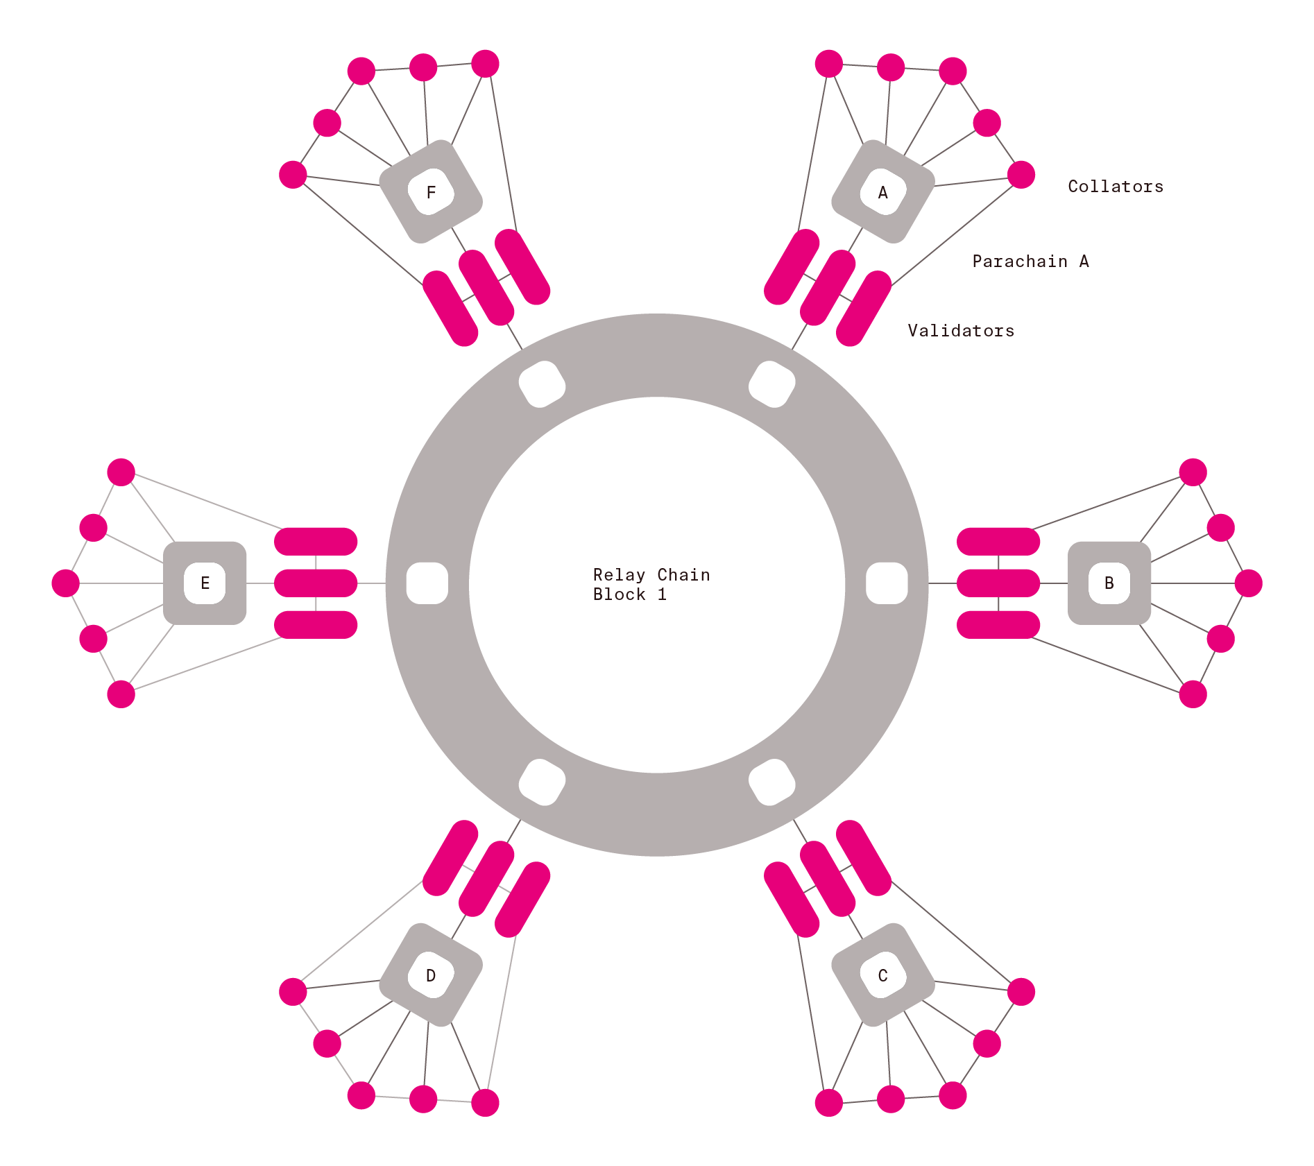

POLKADOT:
Polkadot is a blockchain that connects a
and secures other blockchains.
Two big features of Polkadot are
shared security and interoperability.
Notes:
Opt-in pooled security of all attached chains
The relay-chain validator set can manage external bridges

Slide 7
Polkadot:
Details
Consensus: GRANDPA finality gadget + BABE block production.
Validator Selection: Nominated Proof of Stake (NPoS).
Governance: On-chain lock voting in referendums with adaptive quorum biasing.

Slide 8
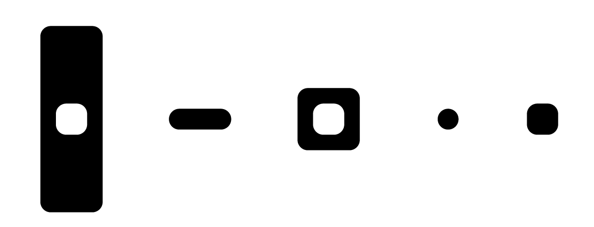
Breaking Down Polkadot
Relay Chain
Validator
Parachain
Collator
Block

Slide 9
The relay chain secures parachains and relays messages between them
Relay Chain

Slide 10
Validators are staked full nodes that are responsible for verifying and adding blocks to the relay chain.
Validators
Notes:
Validators -Manage relay-chain block authorship
-Parachain Candidate agreement
-Steward availability of external data
-Rewarded via staking-token expansion

Slide 11
Parachains are parallelizable blockchains (“para-chains”) that comprise the Polkadot network.
Each parachain can have a unique architecture.
Parachains

Slide 12
Collators
Collators bundle (or collate) transactions on the parachain they monitor into blocks, and send a proof of this block to validators.
They can also be fishermen.
Notes:
Collators
-Create parachain candidates to give to validators
-Work on single parachain only
-Monitor parachain sub-net for misbehavior
Fishermen - Final line of defense: watch for misbehavior of validators
-Anyone can be a fisherman
-Can trigger the “validity/availability” game and slash bad validators

Slide 13
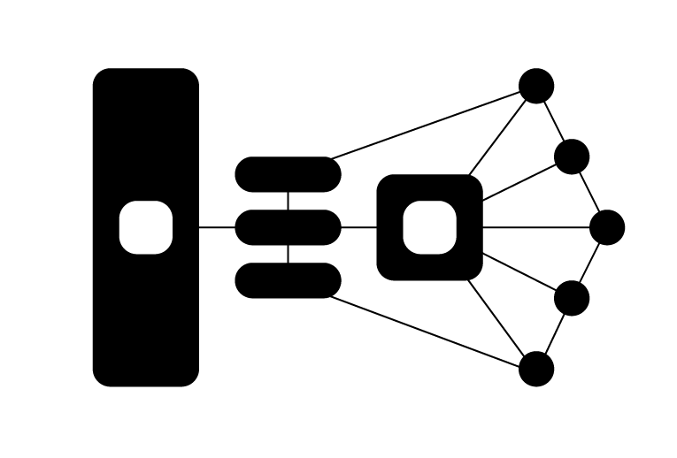
One Parachain
Relay Chain
Validators
Parachain
Collators

Slide 14
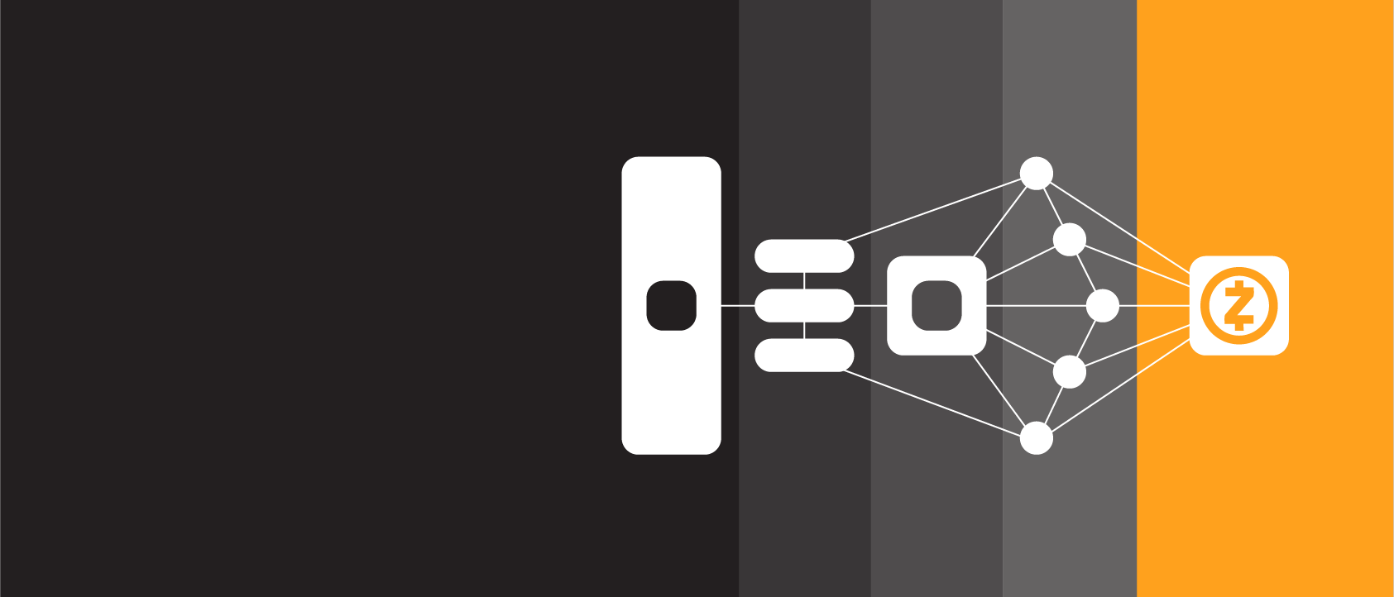
Relay Chain
Validators
Parachain
Collators
External Chain

Slide 15
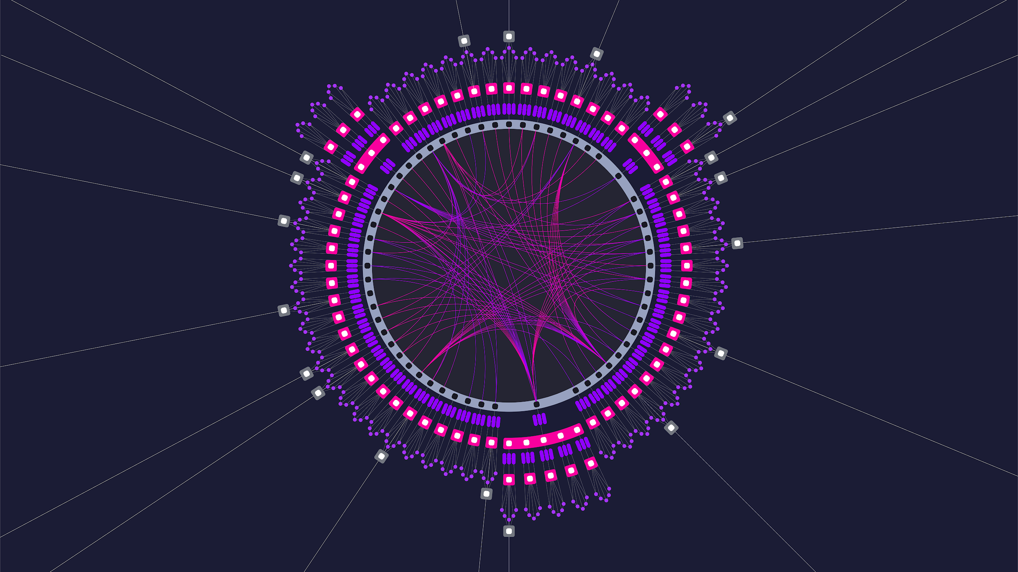
A world running on Polkadot

Slide 16
Consensus

Slide 17
Consensus
The three components that Polkadot comes to consensus over:
BABE - Block production.
GRANDPA - Finality gadget.
Nominated Proof of Stake - Validator selection algorithm.
Notice that block production is separate from finality.
Notes:
Add an equivocations slide for an example.

Slide 18

BABE
Blind Assignment of Block Extension (BABE).
Similar to Ouroboros Praos.
Assigns block production slots according to stake¹ using a VRF.
Validator Set
#69
#70
#71
#72
#73
#74
#75
#76
As we’ll soon learn, each validator should have more or less equal stake and therefore be assigned block production in an equivalent ratio to other validators.
Notes:
Add an equivocations slide for an example.

Slide 19
GRANDPA
GHOST-based Recursive Ancestor Derived Prefix Agreement (GRANDPA).
Byzantine agreement protocol that votes on chains rather than blocks.
Security threshold of up to ⅓ Byzantine nodes then halts finalization until it recovers.
It will recover because BABE can continue and eventually offline validators will be kicked out.
Notes:
Add an equivocations slide for an example.

Slide 20
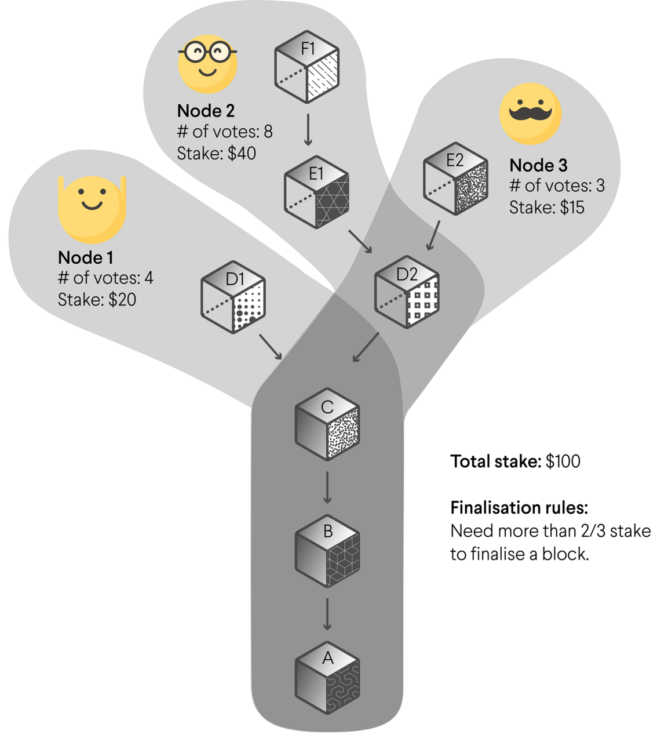
GRANDPA
Notes:
Add an equivocations slide for an example.

Slide 21
Nominated Proof of Stake

Slide 22
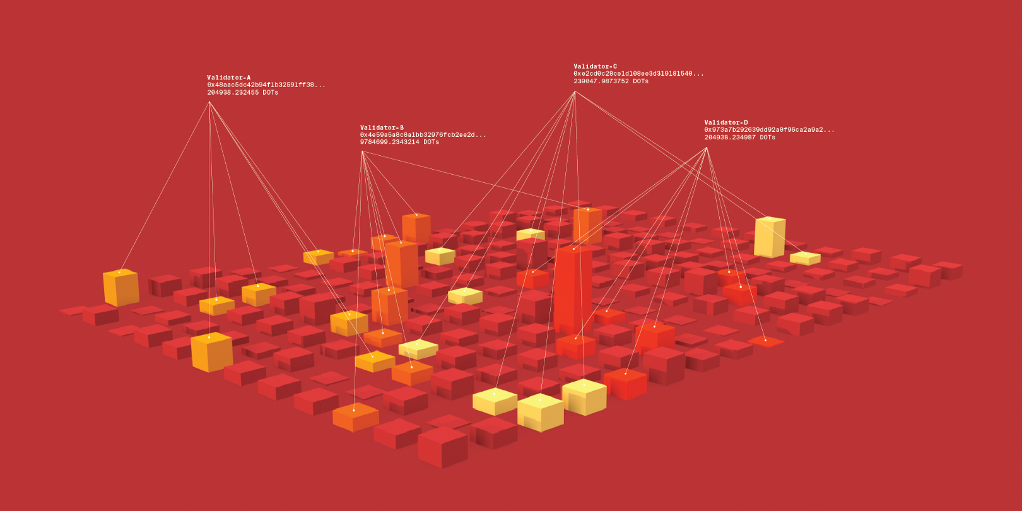
Nominated Proof-of-Stake (NPoS)
Validator spots are limited.
Only the top validators by stake are elected into the validator set.
Validators not elected in the set remain on standby.
Elections happen every era.
Notes:
Add an equivocations slide for an example.

Slide 23
PoW vs. PoA vs. PoS
Proof of Work - Miners solve a computational puzzle to determine
who authors the next block. Downside: Energy consumption, economies
of scale.
Proof of Authority - Authorities produce blocks in a round-robin style. Downside: You have to trust the authorities.
Proof of Stake - Participants stake tokens to take part in the authoring and validation of blocks. Downside: Not very well tested in the wild yet.
Notes:
Add an equivocations slide for an example.

Slide 24
Nominated Proof-of-Stake (NPoS)
A relatively new type of scheme to select participants in the validation systems (i.e. validators).
Permissionless - Any node up to the task can offer itself as a validator candidate.
For operational reasons, only a limited number of validators can be selected.
Expect this number to start at ~100 and then scale up to 1000.
Notes:
Add an equivocations slide for an example.

Slide 25
Nominated Proof-of-Stake (NPoS)
Validator spots are limited.
Only the top validators by stake are elected into the validator set.
Validators not elected in the set remain on standby.
Elections happen every era.
Validators are elected by another staking actor, the nominator.
Notes:
Add an equivocations slide for an example.

Slide 26
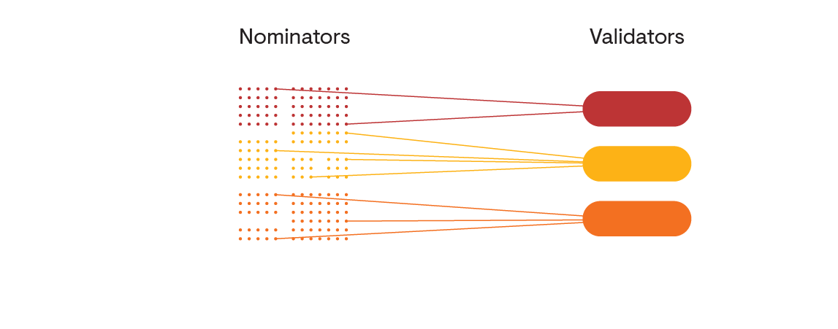

Slide 27
Validators and Nominators
Nominators are staking participants that:
Do not have to run a node.
Elect validators through an “on” or “off” approval voting.
Get reward and punished along with the validators that they are staked to.
Nomination is the set it and forget it approach -- but best do some due diligence on the chosen validations for good security practices and behaviour.
Notes:
Add an equivocations slide for an example.

Slide 28
Phragmen’s Method
Election algorithm used to choose and equalize stake among the validator set.
For the best chances of getting paid out, nominators want to stake to the least staked validators.
Phragmen will do this automatically among the list of validators nominators have approved.
But nominators still have the last say on who they approve.
Notes:
Add an equivocations slide for an example.

Slide 29
Validator 💻

Slide 30
Validators
Validators are staking participants that:
Must run at least a full node for the relay chain.
Directly participate in block authorship, finality, and validity checking.
Able to choose payment preferences before splitting with nominators.
Validators can be viewed as being a service and must stay online and available
with very high up-time. They will be held responsible.
Notes:
Add an equivocations slide for an example.

Slide 31




Types of Nodes
Full Node
Archive Node
Light Client

Slide 32
Validators
Every era, the validator set will change.
The validators that are on standby will move into the active set if they have more stake behind them.
Validators with less stake will move out of the active set.
This will happen every 24 hours on Polkadot (might be different on Kusama).
Notes:
Add an equivocations slide for an example.

Slide 33
Bonding 💌

Slide 34
Bonding and Unbonding
You must bond your funds to participate in staking.
You can bond funds at any time by calling the bond function in the staking module.
If you want to bond more, then simply call the bond_extra function.
If you want to stop participating in staking you must call unbond and wait the bond period before you can withdraw.
After unbonding and waiting the bond period, you call withdraw_unbond to actually free up your funds.
Notes:
Add an equivocations slide for an example.

Slide 35
Slashing 🗡️

Slide 36
Slashing 🗡️
When a validator misbehaves, they and their nominators lose a
percentage of their staked tokens.
The validators with more stake lose more tokens.
Slashing penalties happen because:
Deliberate attacks on the network.
Running modified software.
Severe bugs in the code.
All of these cause a validator to stray from the protocol.
Notes:
Add an equivocations slide for an example.
The risk for heavily backed validators is higher since they will be slashed for more the same amount of reward.

Slide 37
Slashing 🗡️
The yearly interest rate of a validator pool is somewhere
between 10% - 20%, so slashing 1% is a strong punishment,
worth weeks of work…
Level 1: Misconducts that are likely to happen to most validators
such as isolate unresponsiveness. Up to 0.1% of stake.
Level 2: Misconducts that can occur in good faith, but show bad
practices. Examples are correlated unresponsiveness or isolated
equivocations. Up to 1% of stake.
Level 3: Misconducts that are unlikely to happen but do not lead
to significant resource use. Examples are correlated equivocations
or isolated unjustified voting in GRANDPA. Up to 10% of stake.
Level 4: Misconducts that show large levels of collusion and pose
serious security risks. Up to 100% of stake.

Slide 38
Slashing 🗡️
What happens when a validator is found guilty of misconduct?
For all misconducts: They are removed from the list of candidates
for the next NPoS validator election.
For misconducts level 2 and higher: They are immediately marked
as inactive in the current era. (Kicked out.)
For misconducts level 3 and higher: They are removed from all
the nominators’ lists of trusted candidates.
A validator will not be paid while they are kicked out.
Notes:
Balances are deducted from the Stash account of the Slashed entity.

Slide 39
Rewards 💰

Slide 40
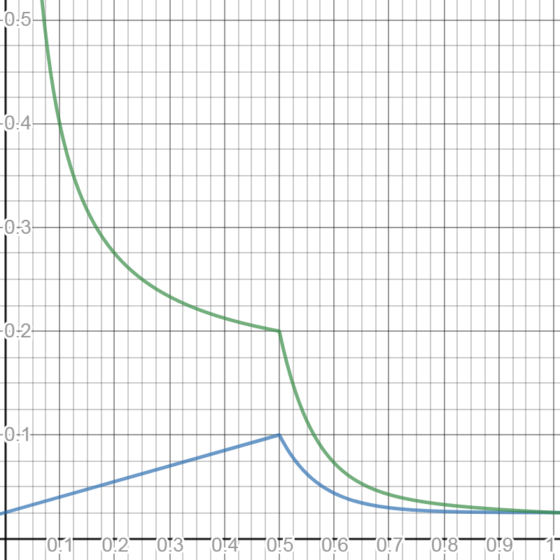
How are rewards paid?
All validators share the rewards equally. Remember - they should all have approximately equal stake nominated to them through Phragmens. (Ideally).
Rewards are determined by payable actions such as block authoring (producing a block in BABE).
Rewards are recorded per session and paid out each era.
On Alexander the session is 5 minutes and era is one hour, but expect these parameters to be different for Polkadot or Kusama.

Slide 41
What are payable actions?
Validity checking: Validators are rewarded for each validity statement of a parachain it issues.
Block production:
For producing a non-uncle block.
For each reference to a previously unreferenced uncle.
The producer of each referenced uncle block.
Payments follow the 20:20:2:1 rule:
For some constant C, the protocol pays 20C for a validity statement, 20C for producing a block, 2C to the block producer for each referenced uncle, and 1C to the producer of each referenced uncle.

Slide 42
Transaction Fees
The producer of a block must be paid transaction fees in order to incentivize inclusion of transactions.
Only a portion of the fee goes to the block producer, with the rest being sent to the treasury.
Original split is proposed to be 20% to the producer and 80% to the treasury.
Like many parameters in Polkadot, this can be changed by governance.

Slide 43
How are rewards determined?
X-axis: % DOTs staked
Y-axis: Annualized %
Return based on staking participation
Inflation rate
Notes:
Targets 20% return and 10% inflation

Slide 44
How much do validators get paid?
Validators are able to set payment preferences for taking a service fee before rewards are split by the nominators.
The service fee is a fixed percentage of rewards rather than a set amount of rewards.
The service fee is there to pay validator operational costs.
After this, validators are paid same as nominators, pro-rata to the amount they are staked.

Slide 45
https://docs.google.com/spreadsheets/d/1vxHpPJ1N0UFmrdyHs20cBvehkyPtVPffp8qgUtNiCto/edit?usp=sharing
Rewards Calculation
Notes:
Targets 20% return and 10% inflation

Slide 46
Security 🔒
Notes:
Add some notes on: - Sentry Nodes - Cloud Infrastructure - HSMs

Slide 47
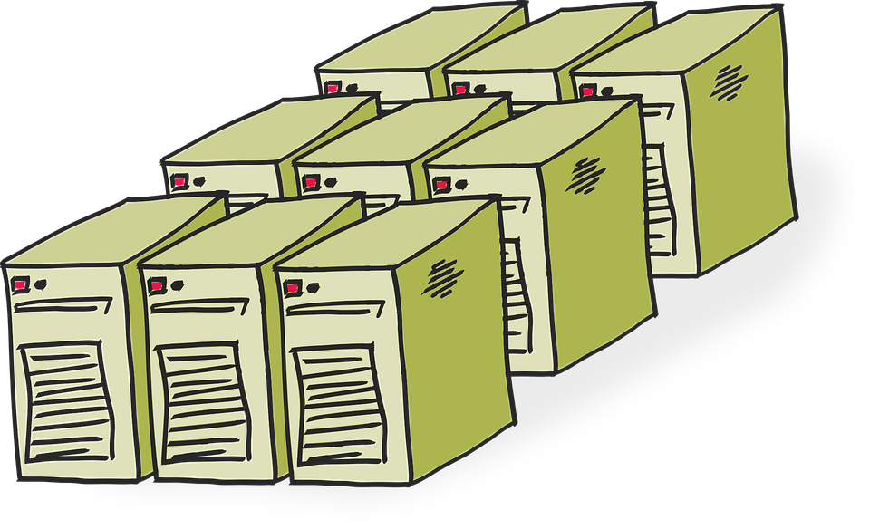
Hosting
Cloud hosting is an option, but not the best.
Why? It could lead to correlated slashing and centralization risk.
The best option is to co-locate in a data center that you trust.
Usually this is more expensive, but will give you more credentials
and is more secure.
Another option is to DIY, or run the infrastructure yourself.
This is only a good option if you really know your stuff.
Notes:
Add an equivocations slide for an example.

Slide 48
Key Management
As a validator you will need to keep track of 3 keys.
Stash key: Holds all the funds, should be kept offline and possibly in cold storage.
Sets the controller key.
Controller key: Controls whether an account is validating, nominating or chilling.
Sets the session key.
Session keys: The live keys stored in the node keystore.
Stash
Controller
Session
Bonding
Holds funds
Sets preferences
Sets staking mode
Author blocks
Finalize chains
Notes:
Add an equivocations slide for an example.

Slide 49
HSMs
A tamper-proof, secure element that is never exposed to the file system of your machine during signing.
Makes it very hard for attackers to extract the private key.
Two examples:
YubiHSM2 (Ed25519 support)
Ledger Nano S
Unfortunately neither of these yet support the SR25519 crypto required for BABE.
But maybe there still might be a way? (Hacky solution)
Notes:
Add an equivocations slide for an example.

Slide 50
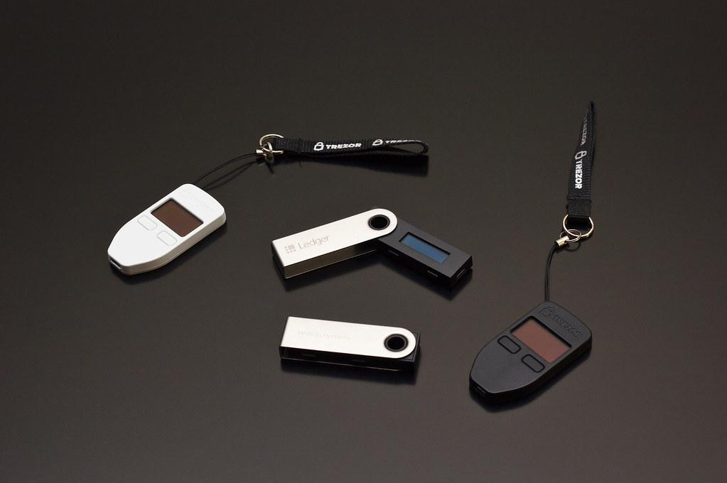
HSMs
A tamper-proof, secure element that is never exposed to the file system of your machine
during signing.
Makes it very hard for attackers to extract the private key.
Two examples:
YubiHSM2 (Ed25519 support)
Ledger Nano S
Unfortunately neither of these yet support the SR25519 crypto required for BABE.
But maybe there still might be a way? (Hacky solution)
Notes:
Add an equivocations slide for an example.

Slide 51

HSMs
A tamper-proof, secure element that is never exposed to the file system of your machine
during signing.
Makes it very hard for attackers to extract the private key.
Two examples:
YubiHSM2 (Ed25519 support)
Ledger Nano S
Unfortunately neither of these yet support the SR25519 crypto required for BABE.
But maybe there still might be a way? (Hacky solution)
Notes:
Add an equivocations slide for an example.

Slide 52
Layered Network Architecture
Protects against DDoS attacks.
Secures your validator in a VPN or behind a firewall.
Operate multiple public facing full nodes on cloud providers that act as the connection between your validator and outside network.
Will also allow validators to connect to each other directly.
These are sometimes known as sentry nodes.
Notes:
Add an equivocations slide for an example.

Slide 53
Layered Network Architecture
Private Network
Polkadot
(Public)
Validator
Sentry Nodes
Notes:
Add an equivocations slide for an example.

Slide 54
Layered Network Architecture
DDoS!
Private Network
Polkadot
(Public)
Validator
Sentry Nodes
Notes:
Add an equivocations slide for an example.

Slide 55
High Availability
Validator nodes should be running with near 100% uptime.
Two examples:
Active standby - Have a backup validator on standby in the case of failure
by the first. (Dangerous - could lead to accidental equivocations).
Active load balancer - Have two or more validators running simultaneously
but behind a load balancer. (Dangerous - could lead to accidental equivocations).
Overall high availability solutions are dangerous!
This is because they are difficult to set up and the slashing penalty for double signing
is higher than for being offline.
Think twice before implementing this in your infrastructure.
Notes:
Add an equivocations slide for an example.

Slide 56
Monitoring Tools

Slide 57
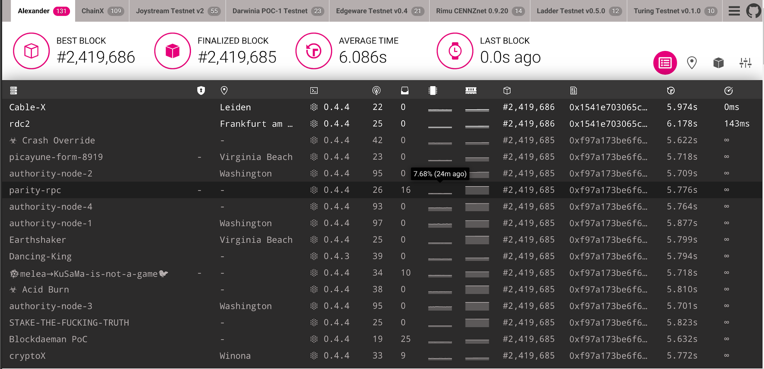
Telemetry

Slide 58
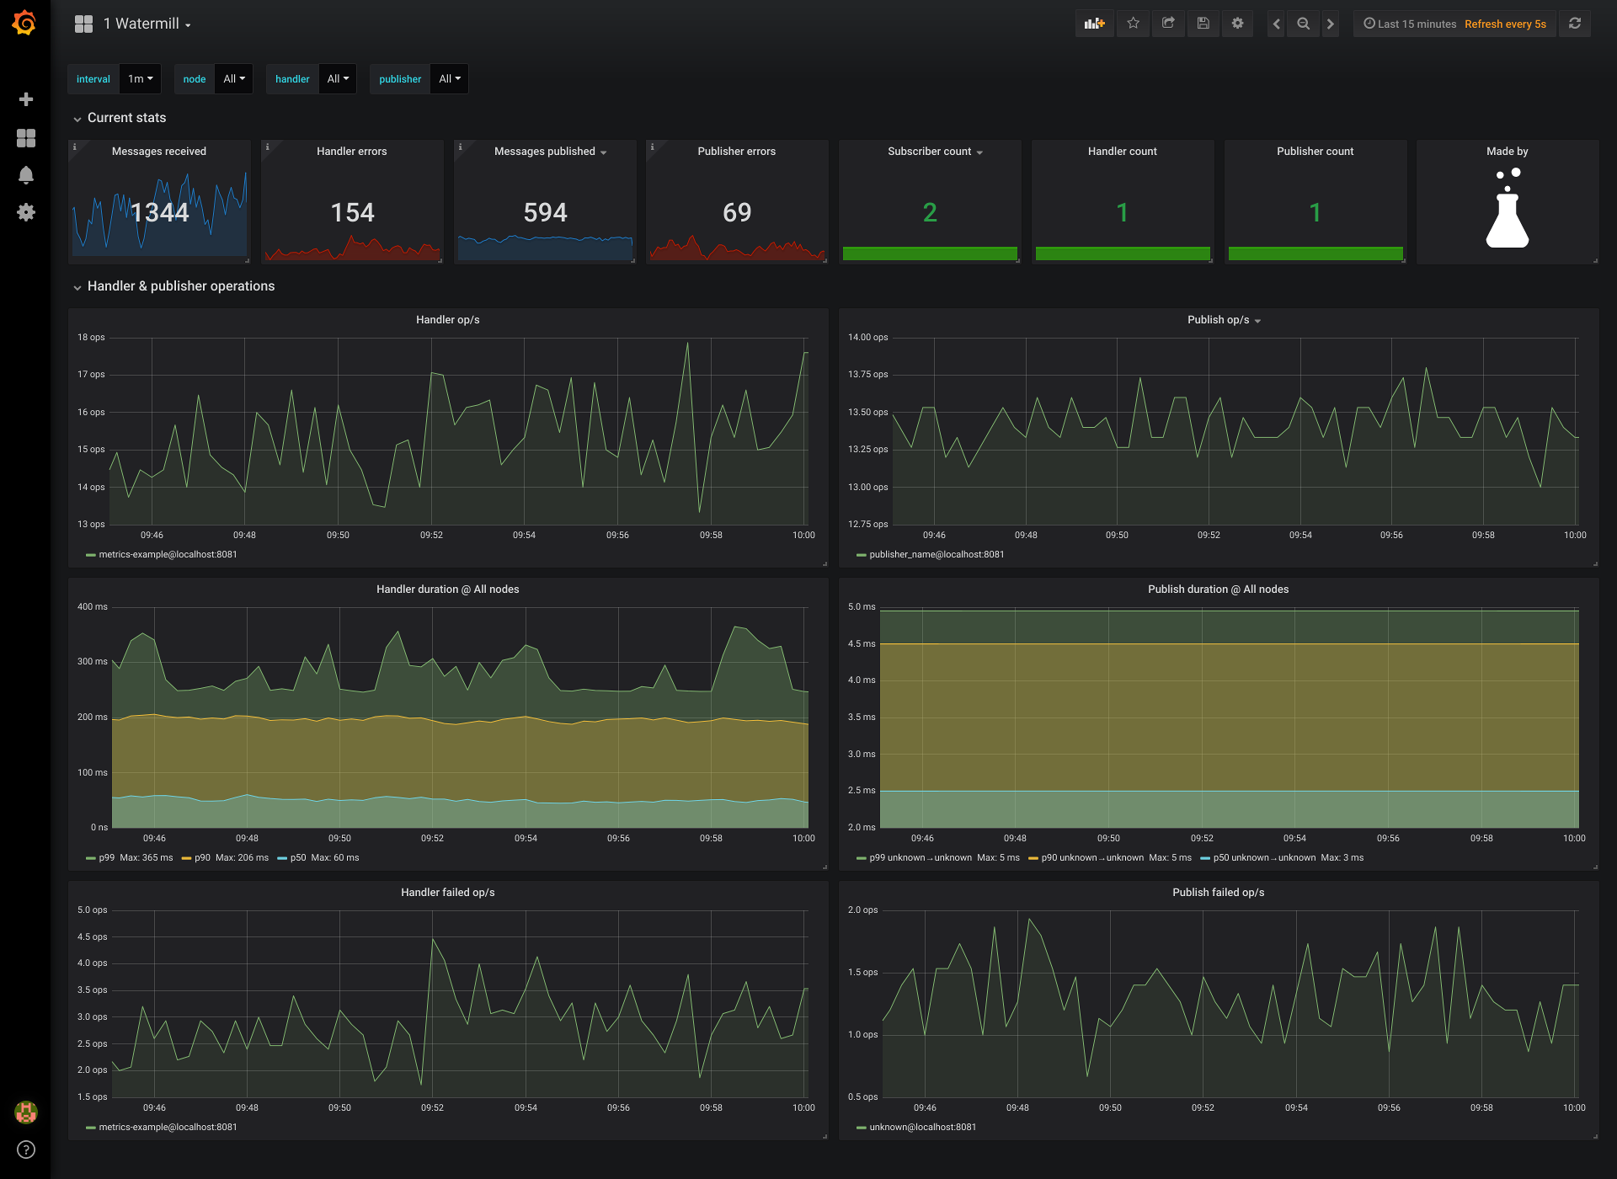
Prometheus / Grafana
Notes:
Prometheus based monitoring stack, including Grafana for dashboards and log aggregation. It includes an alert, query, visualization and monitoring features, and works for both cloud and on-premises systems. The data from substrate-telemetry can be made available to prometheus through exporters like this.

Slide 59
Workshop 👷

Slide 60
Docker
https://docs.docker.com/install/

Slide 61
Polkadot Image
docker pull parity/polkadot:v0.4.4

Slide 62
Polkadot UI
https://polkadot.js.org/apps

Slide 63
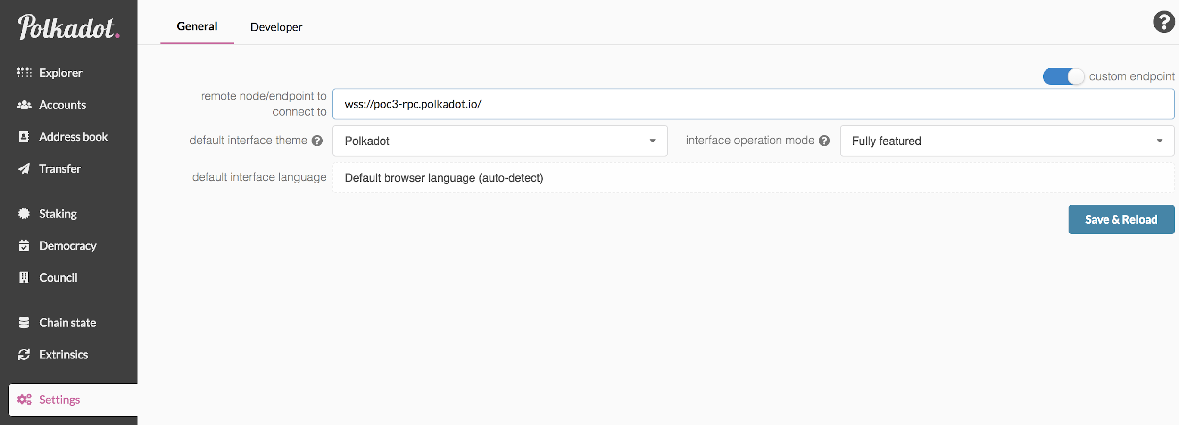
Connect to testnet
Go to https://polkadot.js.org/apps/#/explorer and click on Settings.
Click on Custom Endpoint.
Set remote node address.
Click “Save & Reload”.
2
3
4
1

Slide 64
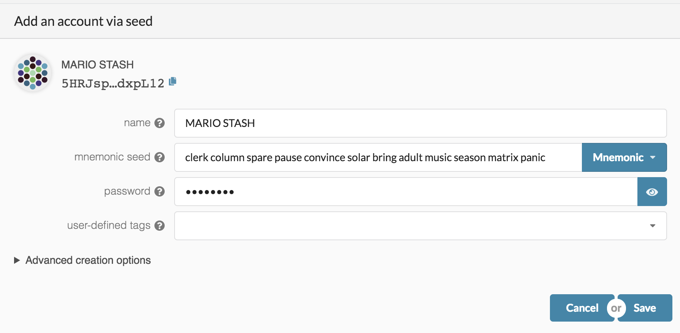
Create a stash account
Give yourself a name with a STASH suffix.
Copy down the mnemonic phrase.
Enter a password.
Click “Save”.
1
2
3
4

Slide 65
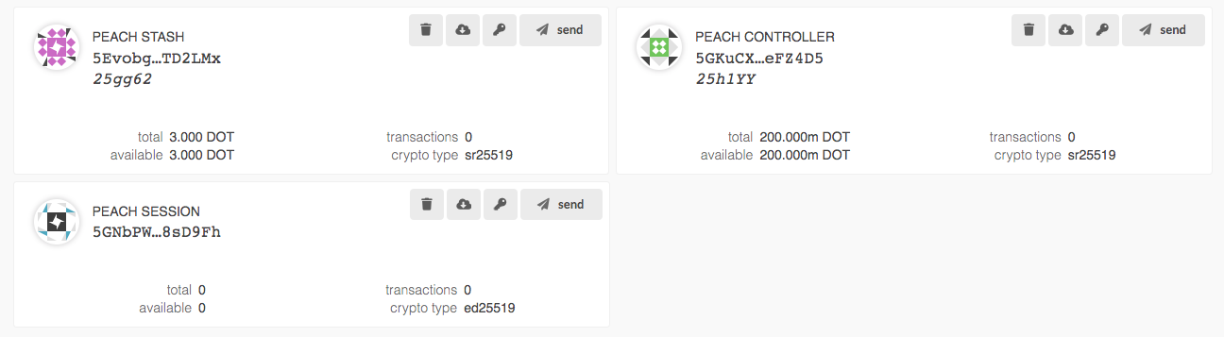
Create controller and session
Do the same twice more.
One for CONTROLLER.
One for SESSION.
Note crypto type for Session is ed25519

Slide 66
Get DOTs
Use the faucet (require Twitter) https://faucet.polkadot.network

Slide 67
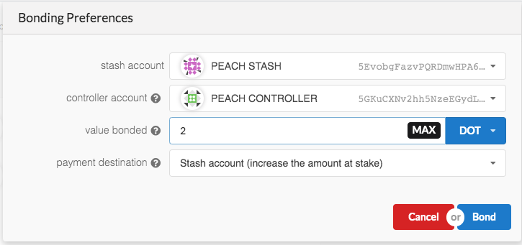
Bond DOTs
Go to the “Staking” tab and click “New Stake”
Enter the relevant Stash and Controller accounts generated earlier
Note: you do not have to bond ALL of the DOTs in your Stash account - any bonded DOTs are liable to be slashed in case of misbehavior.

Slide 68
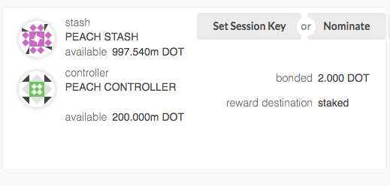
Set session key
After entering the password, signing, and submitting the extrinsic, you should see a new stake.

Slide 69
Start your validator
Using Docker
docker run parity/polkadot:v0.4.4 --name <name> --validator --key <mnemonic or seed>

Slide 70
Telemetry
https://telemetry.polkadot.io

Slide 71
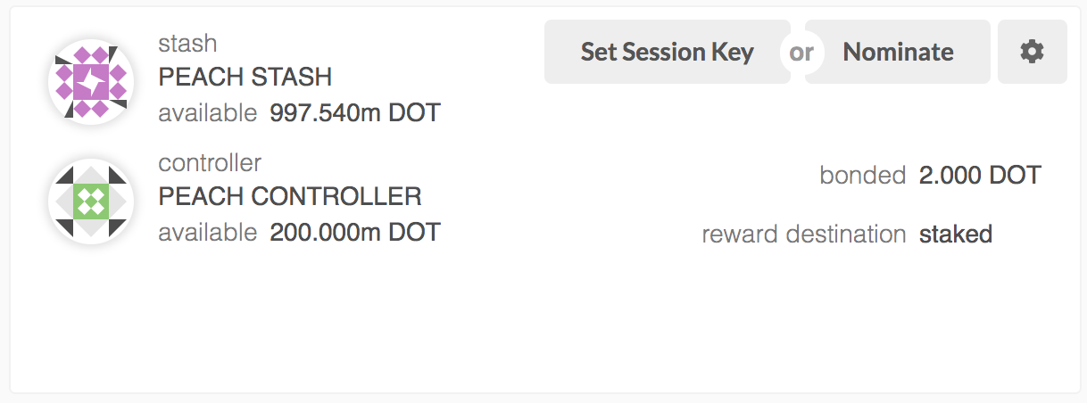
Apply to be a validator
Go back to the Polkadot Explorer
Select the “Staking Tab”
Select “Account Actions”
You should see your bonded DOTs

Slide 72
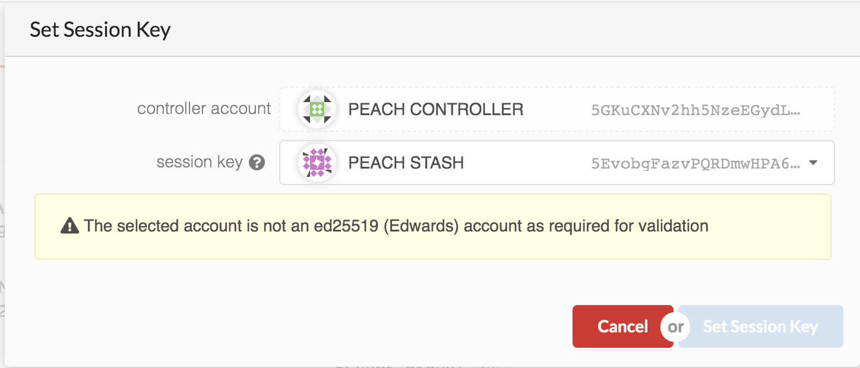
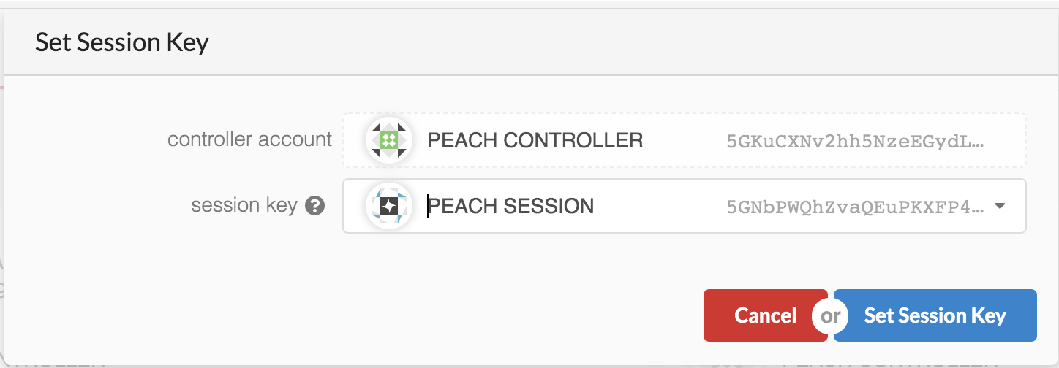
Apply to be a validator
Click “Set Session Key”
If you did not generate an ed25519 key for your Session account, you will get an error at this point
If you did generate an ed25519 key, select that account
😞
😁

Slide 73
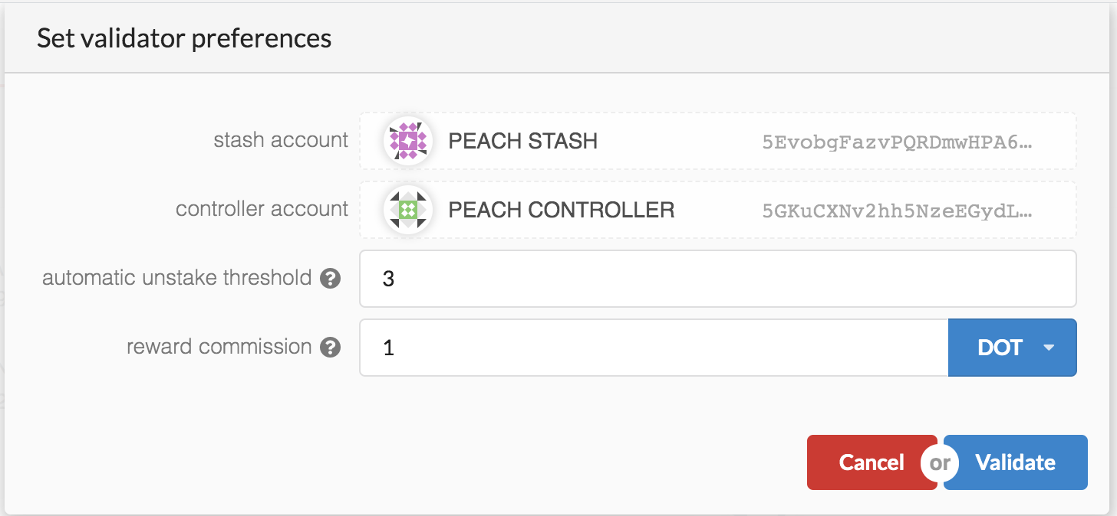
Apply to be a validator
Click on Validate
You can now set the parameters of your validator - how often you can be slashed before you give up your role as validator, and how much you want to take from the rewards before sharing with nominators

Slide 74
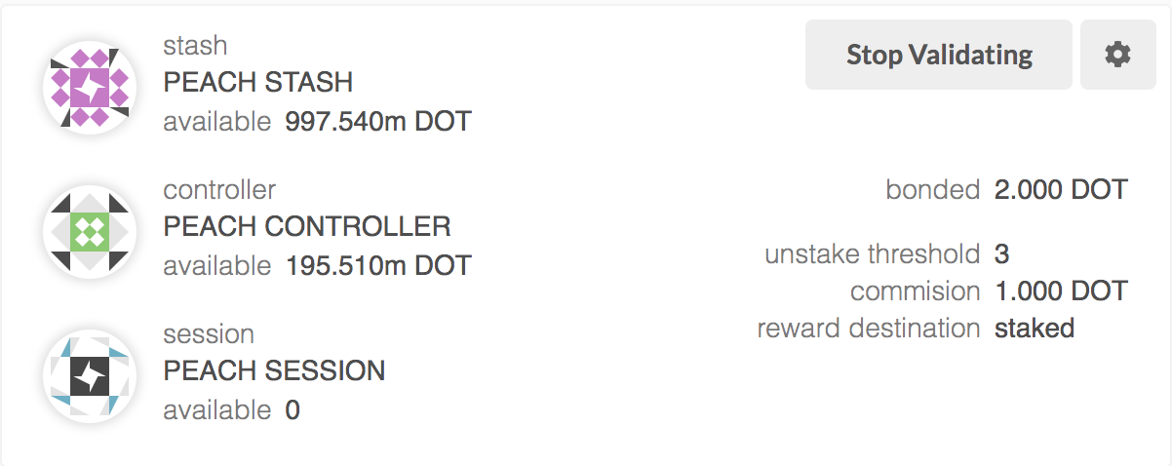
Apply to be a validator
Sign and submit. You should see an “Extrinsic Success” message.
You have now signaled your intention to run a validator - although note that you are not actually validating blocks yet!

Slide 75
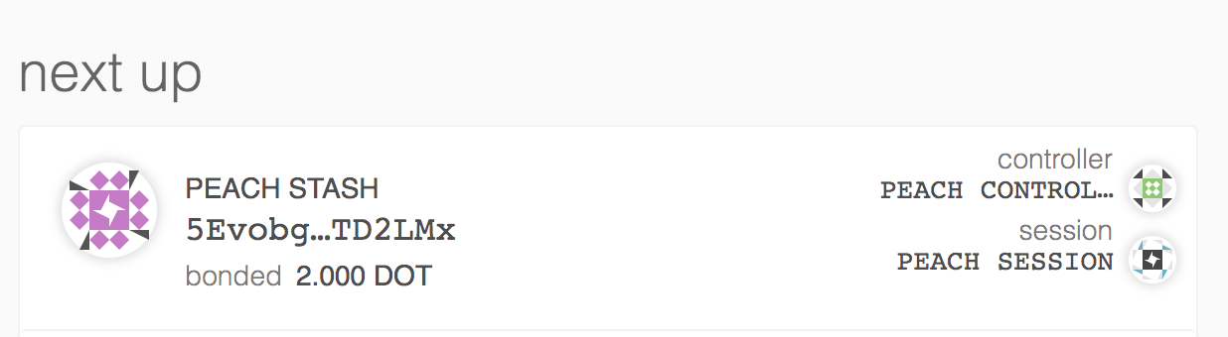
Waiting to validate
Validators are chosen at the beginning of each era
Click on “Staking Overview”. You should see your account in the “Next up” queue.

Slide 76
Validating
Validators are chosen at the beginning of each era
Wait a while, have some cake, and see if you are selected to start validating blocks!

Slide 77





FIND OUT MORE
polkadot.network
kusama.network
wiki.polkadot.network
guide.kusama.network
web3.foundation
Grants: grants.web3.foundation
@polkadotnetwork
#polkadot-watercooler:matrix.org

Slide 78
Q&A

Slide 79
Networking

